Slide 1

**args

Slide 2
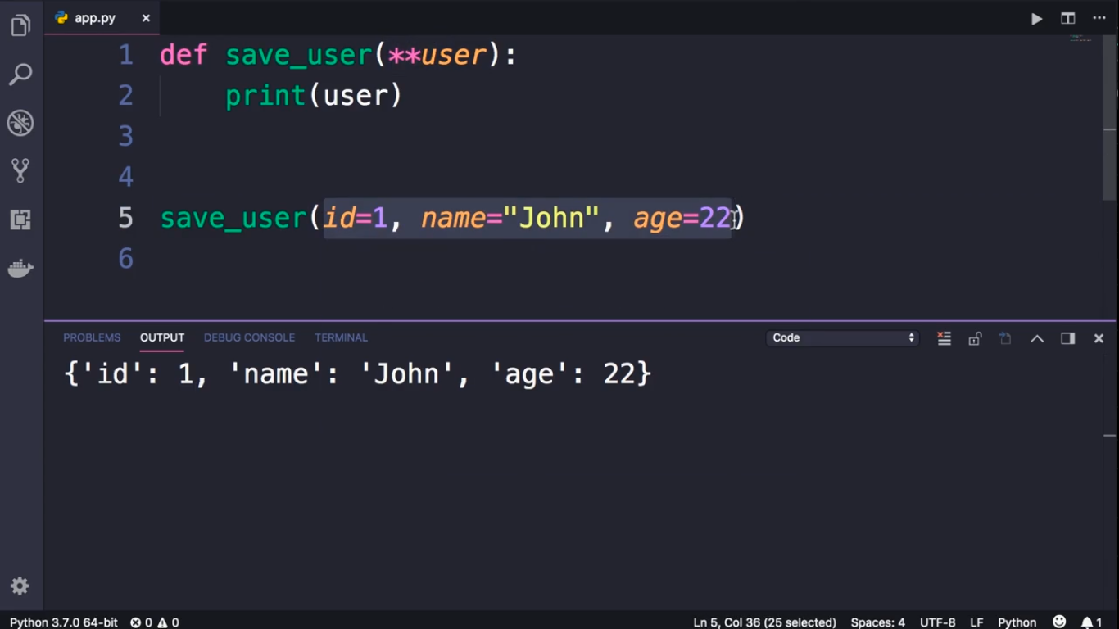
Dictionary

Slide 3
